Slide 1

Hospital Admission Data Project
Power BI Dashboard Analysis
Presented by: Ahmed Adebowale A.
Power BI Internship Project
Tech Studio Academy
July 2026
Tools: MySQL | Power BI | Power Query | DAX

Slide 2
Project Overview
POWER BI INTERNSHIP PROJECT | TECH STUDIO ACADEMY 2026
Executive Summary
This project analyzes hospital admission data using MySQL and Power BI to identify trends in patient admissions, readmissions, treatment costs, and patient outcomes. The dashboard provides actionable insights that support informed healthcare decision-making and improve hospital performance.
Project Objective:
Examine the total number of patient admissions.
Identify admission patterns across hospital departments
Compare patient volumes to understand departmental workload and service demand.
ANALYZE PATIENT ADMISSIONS
Track key performance indicators (KPIs) such as average length of stay, treatment cost, and readmission rate.
Evaluate departmental performance to identify strengths and areas requiring improvement.
MONITOR HOSPITAL PERFORMANCE
Analyze readmission rates by age group, department, and month.
Identify patient groups with a higher likelihood of readmission to support targeted interventions.
IDENTIFY HIGH-RISK PATIENTS
Assess the average treatment cost across departments and patient outcomes.
Identify high-cost departments and determine whether higher spending is associated with improved patient outcomes.
EVALUATE TREATMENT COSTS
Analyze the distribution of patient outcomes, including Recovered, Improved, Referred, and Deceased.
Evaluate how patient outcomes relate to treatment costs and length of stay to support quality improvement initiatives.
TRACK PATIENT OUTCOMES

Slide 3

Dataset Overview
POWER BI INTERNSHIP PROJECT | TECH STUDIO ACADEMY 2026
Hospital Admissions Data Set
The dataset contains records of patient admissions
across eight hospital departments and includes
demographic, treatment, and outcome information.
Total Patients
Departments
1,000
8
Months Covered
  January – December
Age Groups:
  0–18 | 19–40 | 41–60 | 61+
Patient Outcomes
  Recovered | Improved
  Referred | Deceased

Slide 4

Data Preparation
POWER BI INTERNSHIP PROJECT | TECH STUDIO ACADEMY 2026
Data Cleaning and Transformation
The following steps were completed before analysis
Imported CSV into Power BI
Checked for missing values
Removed duplicates
Corrected data types
Created Age Group column using Power Query
Built DAX measures for KPI calculations

Slide 5
DAX Measures
POWER BI INTERNSHIP PROJECT | TECH STUDIO ACADEMY 2026
Key Performance Indicators
The following DAX measures were created
Total Patients =
COUNTROWS(Hospital)
Average Length of Stay =
AVERAGE(Hospital[Length_of_Stay])
Average Treatment Cost =
AVERAGE(Hospital[Treatment_Cost])
Overall 30-Day Treatment Rate =
DIVIDE(CALCULATE(COUNTROWS(Hospital),Hospital[Readmitted_30_Days]="Yes"),COUNTROWS(Hospital))

Slide 6
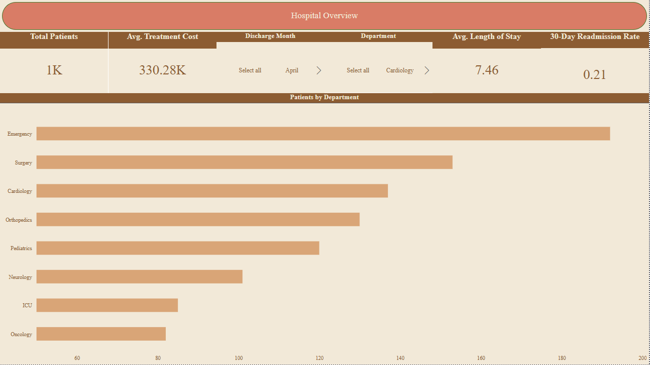
Hospital Overview Dashboard
POWER BI INTERNSHIP PROJECT | TECH STUDIO ACADEMY 2026
Hospital Overview
This page provides a summary of the hospital's overall performance. The KPI cards display the total number of patients, average length of stay, treatment cost, and readmission rate. The bar chart compares admissions across departments, while the slicers allow users to filter the dashboard by department or discharge month.
📊Dashboard Components
📈KPI Cards:
Total Patients
Average Length of Stay
Average Treatment Cost
30-Day Readmission Rate
Patients by Department (Bar Chart)
Interactive Slicers (Department and Discharge Month)
Key Findings
The hospital recorded 1,000 total patient admissions.
The average length of stay was 7.46 days.
The average treatment cost was approximately 330.28K.
The overall 30-day readmission rate was 21%.
The Emergency Department recorded the highest number of patient admissions.
Purpose of This Dashboard
This dashboard provides a high-level overview of hospital performance by summarizing key metrics and enabling users to filter data by department and discharge month for further analysis.
Insight
Emergency recorded the highest number of patient admissions, while Oncology had the lowest.

Slide 7
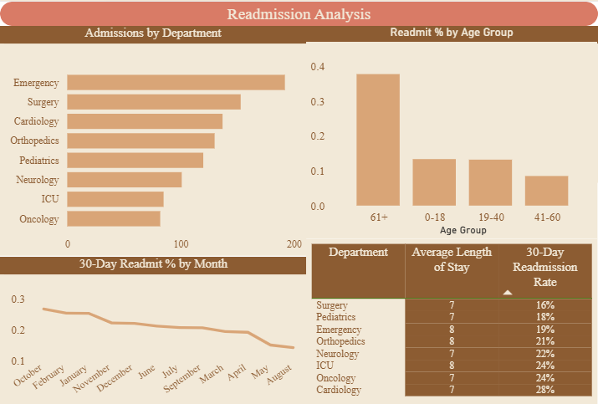
Readmission Analysis Dashboard
POWER BI INTERNSHIP PROJECT | TECH STUDIO ACADEMY 2026
Dashboard Includes
Monthly Readmission Trend
Readmission Rate by Department
Readmission Rate by Age Group
Department Performance Table
Key Insights
October recorded the highest readmission rate.
Cardiology had the highest readmission rate (28%).
Patients aged 61+ experienced the highest readmission rate.

Slide 8
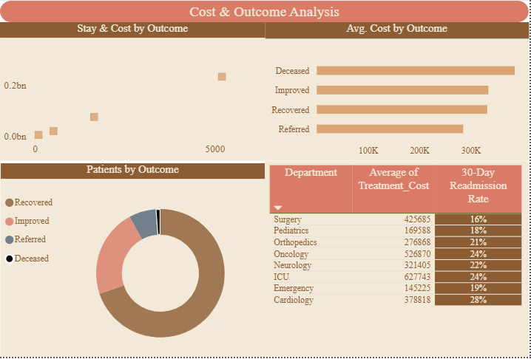
Cost & Outcome Analysis Dashboard
POWER BI INTERNSHIP PROJECT | TECH STUDIO ACADEMY 2026
Dashboard Includes
Patient Outcome Distribution
Average Treatment Cost by Outcome
Length of Stay vs Treatment Cost (Scatter Chart)
Department Cost Analysis
Key Insights
Most patients recovered successfully.
ICU recorded the highest treatment cost.
Higher treatment costs did not always result in better patient outcomes.

Slide 9
Business Insight
POWER BI INTERNSHIP PROJECT | TECH STUDIO ACADEMY 2026
Key Findings
Readmissions
October had the highest readmission rate.
Cardiology requires closer monitoring due to its high readmission rate.
Patient Risk
Elderly patients (61+) are at the greatest risk of readmission.
Cost
ICU and Oncology incur the highest treatment costs.
Outcomes
Recovered patients represent the majority of hospital discharges.

Slide 10
Recommendation
POWER BI INTERNSHIP PROJECT | TECH STUDIO ACADEMY 2026
Recommendations
Improve discharge planning for elderly patients.
Strengthen follow-up care to reduce readmissions.
Review treatment processes in Cardiology.
Monitor spending in high-cost departments such as ICU and Oncology.
Continue using Power BI dashboards for ongoing performance monitoring.

Slide 11

Conclusion
POWER BI INTERNSHIP PROJECT | TECH STUDIO ACADEMY 2026
Conclusion
Key Takeaways
This project successfully transformed raw hospital data into an interactive Power BI dashboard that provides valuable insights into patient admissions, readmissions, treatment costs, and outcomes.
The dashboard enables healthcare managers to monitor key performance indicators, identify high-risk areas, and make informed decisions to improve patient care and operational efficiency.
Developed an interactive Power BI dashboard to monitor hospital performance.
Identified departments and patient groups with higher readmission risk.
Provided data-driven recommendations to improve patient care and resource allocation.
THANK YOU

